Slide 1
Patient Identification

Slide 2
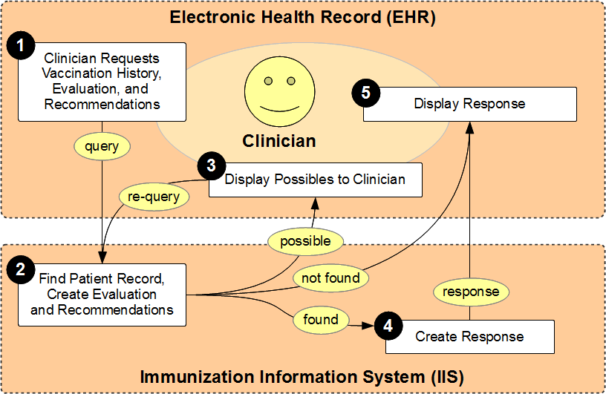
Use Case
Notes:
This workgroup focused on the portion of the use case within the red box.
There are two additional possibilities (in addition to possible matches found, exact match found, and not found) which we discussed.
A match was found for the query, but the patient record cannot be returned because the patient has opted out of the registry
A match was found for the query, but record cannot be returned because the patient is in a merge queue awaiting a human review and the record is not complete

Slide 3
High Level Decisions
 | R | P | D
IIS patient id should be utilized for patient matching. | X
EHR patient id should be utilized for patient matching. | X
IIS should return an exact match based on the patient demographics when the patient ids are not recognized. | X
IIS should return possible match(es) based on patient demographics when an exact match is not found. (Where allowed by local IIS policy and regulation.) | X
EHRs should support the return of possible matches by allowing the EHR user to pick correct match and re-query. | X
Notes:
Some felt that the use/storage of the IIS patient ID should be permitted rather than recommended because IIS IDs can change and not all IIS can search based on the old IIS ID.
Some members of the group felt that asking the EHRs to display possible matches was too much of a burden, however our workgroup felt that the increased data quality and benefits to patient care justified the work involved
Ask this question to physicians: do they want to be able to select from a list of patients?

Slide 4
EHR Functionality
 | R | P | D
The EHR should be able to store the IIS patient id as part of the patient record. | X
The EHR should display the IIS patient ID to the user |  | X
The EHR should automatically store the IIS patient id on records when it receives back an exact match. | X
The EHR could provide the clinician with the ability to indicate that an incorrect match was found and prevent the data from populating the patient’s record. |  | X
The EHR should store the IIS patient id on the patient record when the user confirms the match. | X
The EHR should allow user to remove or delete the IIS patient id from the patient record. |  |  | X
The EHR should allow the user to edit, update or add the IIS patient id to the patient record. |  |  | X
Notes:
Consideration is that not all IIS store previous IIS IDs that were lost as a result of a merge
Allowing user to edit the IIS ID in the EHR;
PROS: In cases where the IIS does not return a match after a query, if the clinician knows that the patient exists in the IIS, he/she may be able to enter the IIS ID manually and subsequent queries will be successful.
CONS: The user may enter the IIS ID incorrectly which could result in data quality problems in the IIS (depending on the business rules of the IIS)
A consideration for the future is the possibility of having an MCI/MPI that will be used by various public health programs; providing the MCI ID back could solve a lot of problems related to patient identity resolution.

Slide 5
EHR FUNCTIONALITY (Cont)
 | R | P | D
When the EHR queries it should use the demographic record that is has recorded in the EHR. | X
The EHR should send patient demographics when querying by id. | X
The EHR should send an EHR patient id with every update to the IIS. | X

Slide 6
Resolving multiple matches
 | R | P | D
When the EHR queries again to get an exact match it should use the demographic record that is has recorded in the EHR. |  | X
When the EHR queries again to get the exact match it should use the demographic data from the patient that was sent back from the IIS and which the user selected. |  | X
When the EHR re-queries (based on the clinician’s selection), the IIS ID should be used in the re-query. | X
Notes:
Demographic information is not required for resolution of multiple matches assuming that the IIS ID is sent as part of the re-query.

Slide 7
IIS FUNCTIONALITY
 | R | P | D
The IIS should associate EHR patient ids with patient records. | X
The IIS should remember all EHR patient ids, even if the IIS has two or more EHR patient ids for the same patient from the same practice. (This would happen if the EHR has a duplicate and assigned the same person two different patient ids, and the IIS was able to merge the records. The IIS will need to keep both ids.) |  | X
The IIS should use the EHR patient id as a strong query parameter for the site that submitted that EHR patient id originally. | X
The IIS should not automatically return an exact match based on patient ID alone; other patient demographics should be considered | X
Notes:
Special case: If the EHR did an initial query that resulted in multiple possible matches and the clinician selected a single match, then IIS can return a match based on ID alone.

Slide 8
Key query Parameters
Patient first name
Patient last name
Patient date of birth
EHR patient ID
IIS patient ID
SSN (where jurisdiction allows)
Gender
Patient middle name
Phone number
Address
send all other demographic information that you have that is used in a QBP

Slide 9
Future Considerations
Message responses for opt-out, pending, other situations where a patient could not be returned but may be in the IIS
Changing of patient IDs due to merging, providers changing EMRs. Should IIS log these or store these?
Hosting organization (ex. EHR hub); how to associate the EHR patient ID (being addressed by another workgroup)

Slide 10
Future considerations (cont)
HL7 implementation guide should address the proper workflow: query first (both for the immunization info/forecast and to obtain the IIS patient ID), then VXU submission, follow up query to obtain updated clinical decision support
Should there be a mechanism for the EHR to notify the IIS that an incorrect match was found?
Should we create a limit to the number of matches that can be returned? What is a realistic number to expect a provider to be able to sort through?

Slide 11
Next steps
Standardization of error messages
Seek feedback from clinicians
AIRA to engage EHRA on these recommendations
IIS Community assessment on these recommendations; gap analysis
ONC and CMS understanding and buy-in
Present to the HITPC (Health IT Policy Committee) and the HITSC (Health IT Standards Committee)
Test cases for certification to handle exact match and multiple matches
IIS certification

